Slide 1
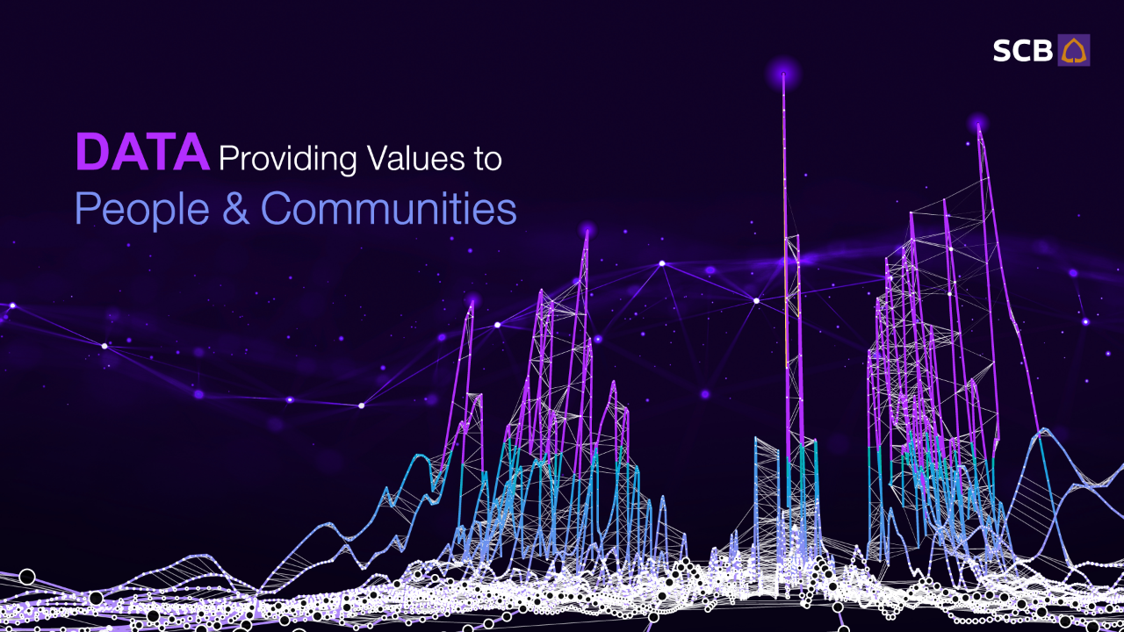


Providing Values to
Customers and Communities through DATA
Ramestr Sasirajpornchai
Principal Data Scientist
Siam Commercial Bank

Slide 2
SCB Data Analytics
Using Data and Analytics to Deliver Meaningful AI Applications to Achieve the SCB’s Vision of Being the “Digital Bank with Human Touch”
Data Scientists
&
Data Analysts
Machine Learning Engineers
Business Analysts
Project Managers
Quality Assurance

Slide 3

How has DATA in SCB Changed in Since Covid
SCB Easy Users
60%
Yearly Digital Transactions
3.7x
Transactions per Customers 2.5x
Digital Product Adoption
90%

Slide 4

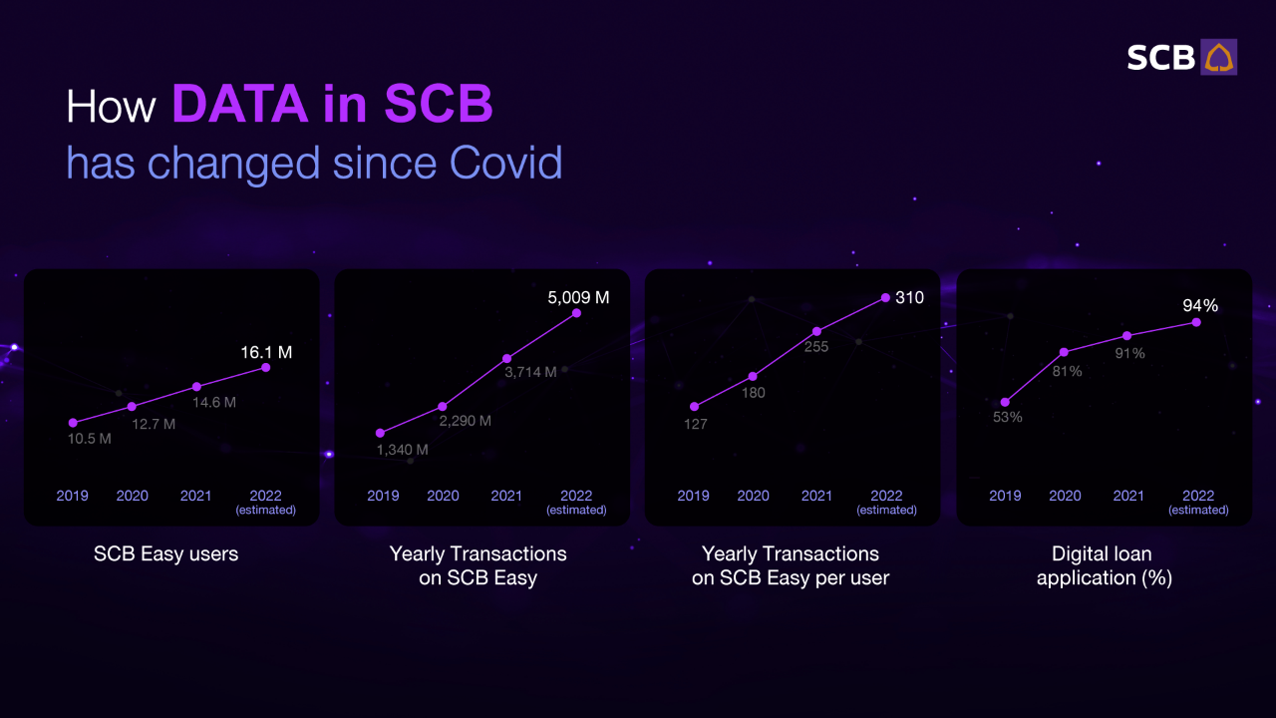

Slide 5
VALUE
We Bring to the Customers
Approval Rate
2x
Easy Access to Lending
Credit Scoring
Income Assessment
Digital Document Processing
Portfolio Optimization
Instant Approval
Default Rate Reduction
30%

Slide 6
VALUE
We Bring to the Customers
Synergize Connected Businesses
Instant Approval
Expanding the Business Ecosystem
Supply Chain Network
Financial Statement Enrichment
Portfolio Risk Management
Access to Younger Businesses

Slide 7
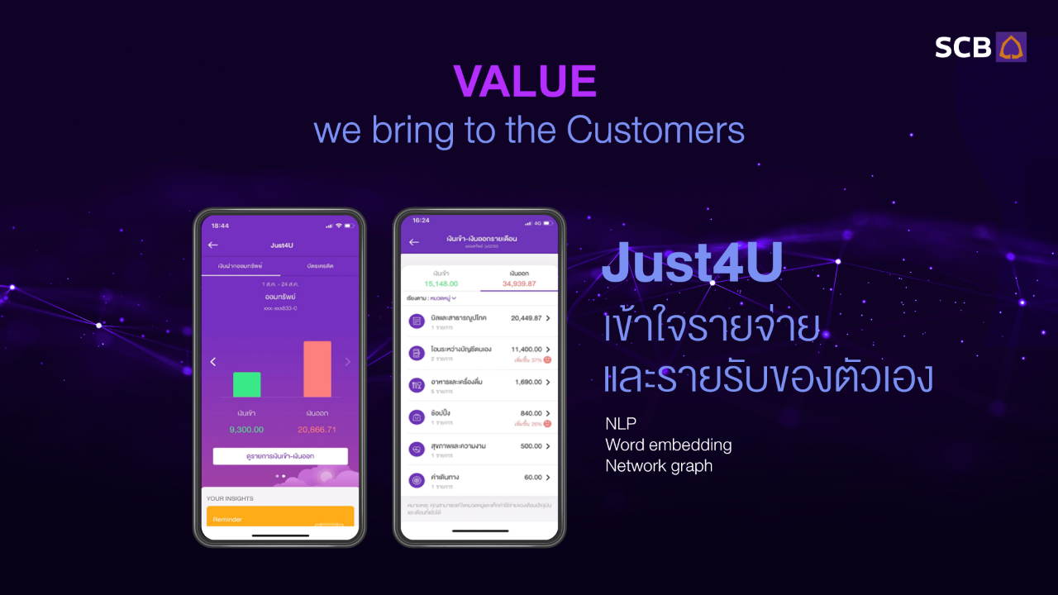

VALUE
We Bring to the Customers
Understand their Finances and Grow their Wealth
Just4You (Personal Finance Management)
Wealth Recommendation
Insurance Recommendation

Slide 8
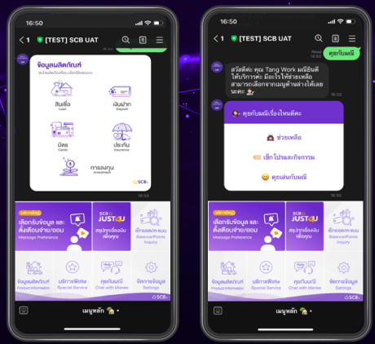
VALUE
We Bring to the Customers
Engage with Customers through Line SCB Connect
Chatbot
Product Inquiry and Information
Intelligent Recommendation

Slide 9

Data Architecture
Real-Time Microservices
Real-Time Microservices
Batch Jobs
Application Layer
Data Analytics
Analytics Layer
SCB Kafka
Real-Time
Event-Based Data
SCB DataLake
Aggregated Data from All Sources
Data Layer

Slide 10
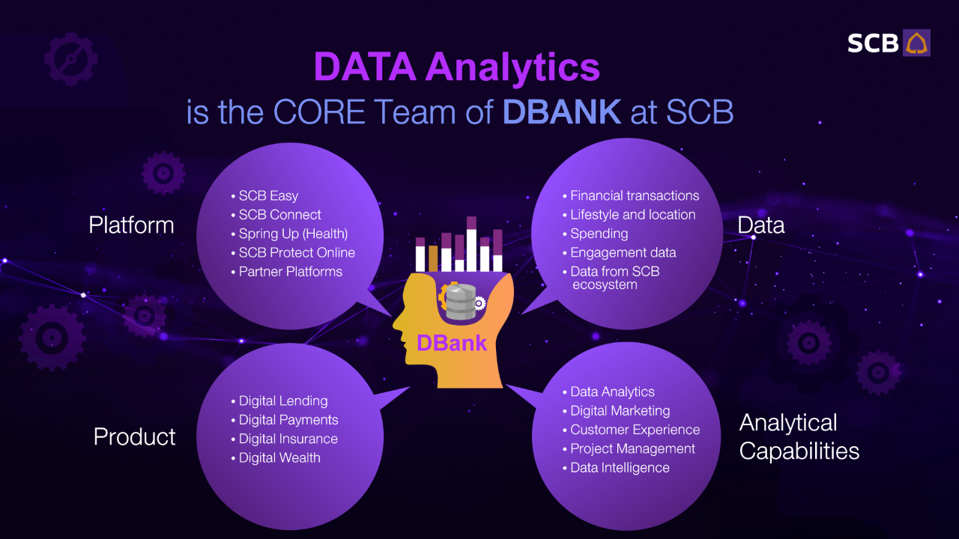

Slide 11
Working with SCB Data Analytics
Get to Work with the Brightest People
Established Data Infrastructure and Analytics Tools
Flexible Working Style
Opportunity to Pursue Your Own Ideas
Sexy Young Generation
Result Driven

Slide 12
Data and Analytics are Exponentially more Effective with the Right Team
Data is Increasing Faster than Data Scientists
Data is Only as Useful as the Analytics and the Applications

